Slide 1
Mean Reversion Pairs Arbitrage
MF703 Final Project
Ren Yuheng / Huang Xiao
Tao Yanliang / Ni Yixin
Chen Fuyu / Zhang Wanchen

Slide 2
Introduction
We study model-driven statistical arbitrage strategies in U.S. equities. Trading signals are generated using sector ETFs.
In this cases, we consider the residuals, or idiosyncratic components of stock returns, and model them as a mean- reverting process, which leads naturally to “contrarian” trading signals.
The term statistical arbitrage encompasses a variety of strategies and investment programs. This idea is to make many bets with positive expected returns, taking advantage of diversification across stocks, to produce a low-volatility investment strategy which is uncorrelated with the market.
Holding periods range from a few seconds to days, weeks or even longer.

Slide 3
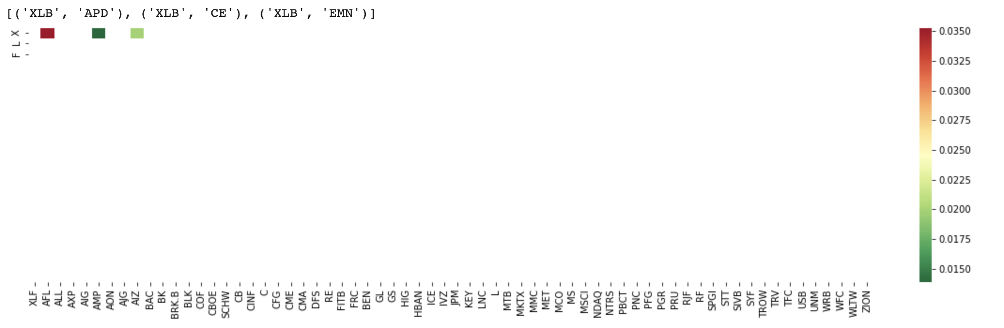
Methodology
Pairs Formation
Pairs are formed based on sector
Our pair consist of one sector ETF and one stock in the same sector
Find cointegrated pairs using cointegration test (Graph shows an example of the Materials sector)

Slide 4
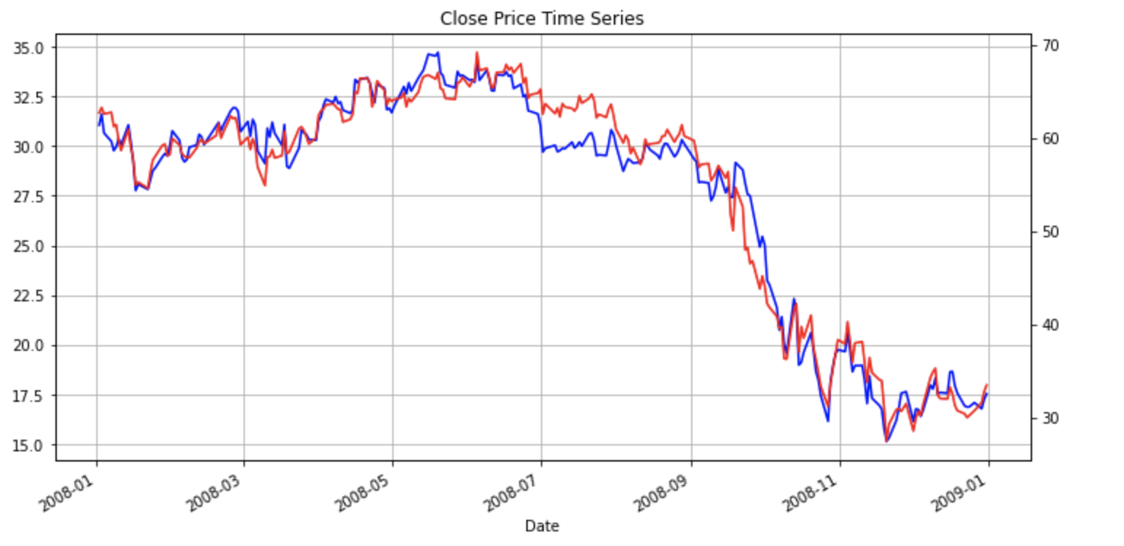
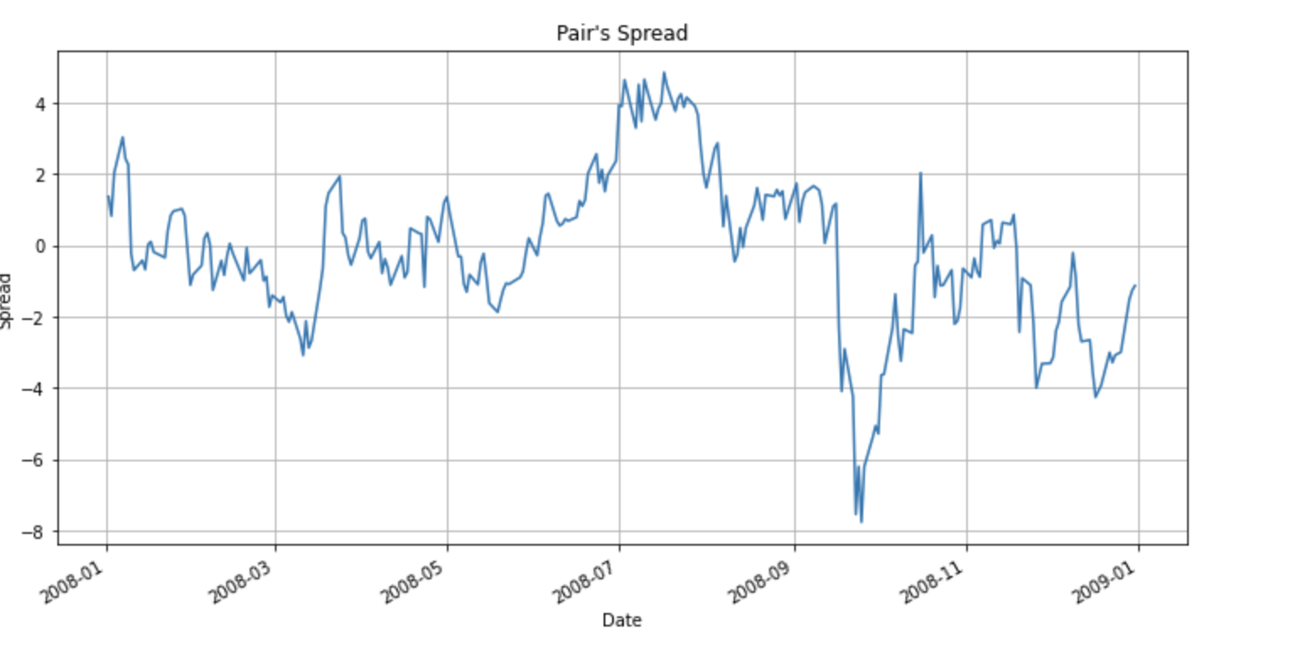
Methodology
Pairs Formation
Test if regression residuals are stationary using adfuller unit root test (Graph shows example of Material sector ETF and stock Air Products & Chemicals

Slide 5
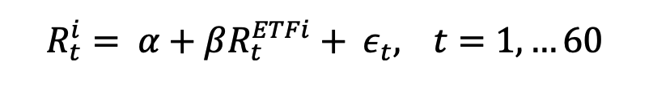
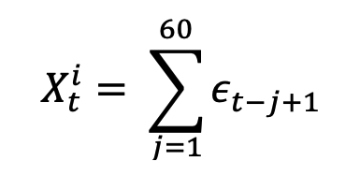

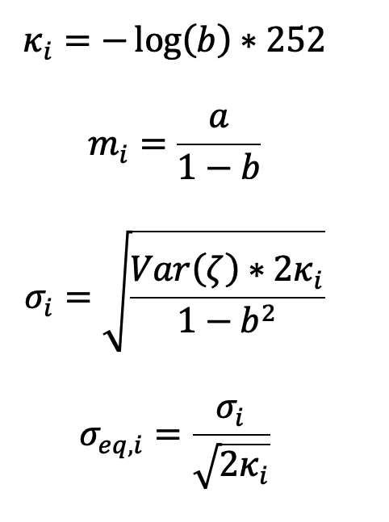
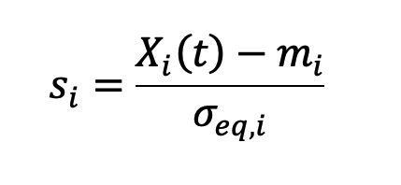
Methodology
Construct S-score ( Trading Signal based on mean - reversion)
- First step:
- Second step:
- Obtained OU parameters from AR(1) process:
- OU parameters are calculated by:
Calculate S-score:
Reference: Marco Avellaneda and Jeong-Hyun Lee. Statistical Arbitrage in the US Equities Market. Quantitative Finance, 10(7):761–782, 2010. Retrieved from https://www.math.nyu.edu/faculty/avellane/AvellanedaLeeStatArb071108.pdf

Slide 6
Methodology
Trading Signal
S-score < - 2: Long stock, Short ETF (Buy to open)
S-score < -0.5: Close position
S-score > +2: Short, Long ETF (Sell to open)
S-score >+0.5: Close position

Slide 7
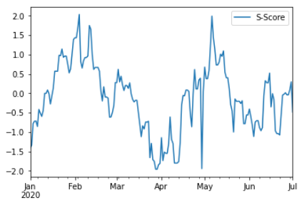
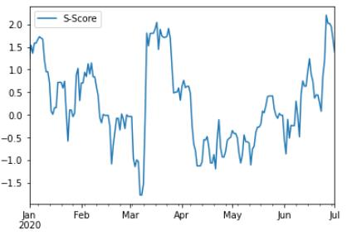
Methodology
Results of S-score:
GOOGL vs. XLC
PXD vs. XLE

Slide 8
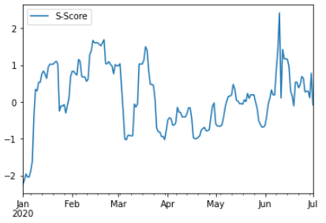
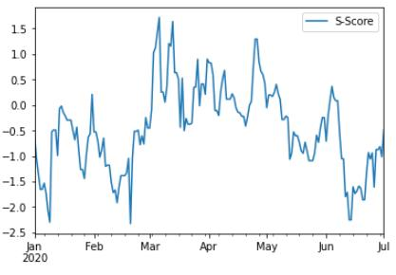
Methodology
Results of S-score:
RFJ vs. XLF
DOV vs. XLI

Slide 9
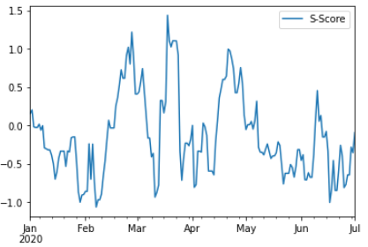
Methodology
Results of S-score:
ANSS vs. XLK

Slide 10
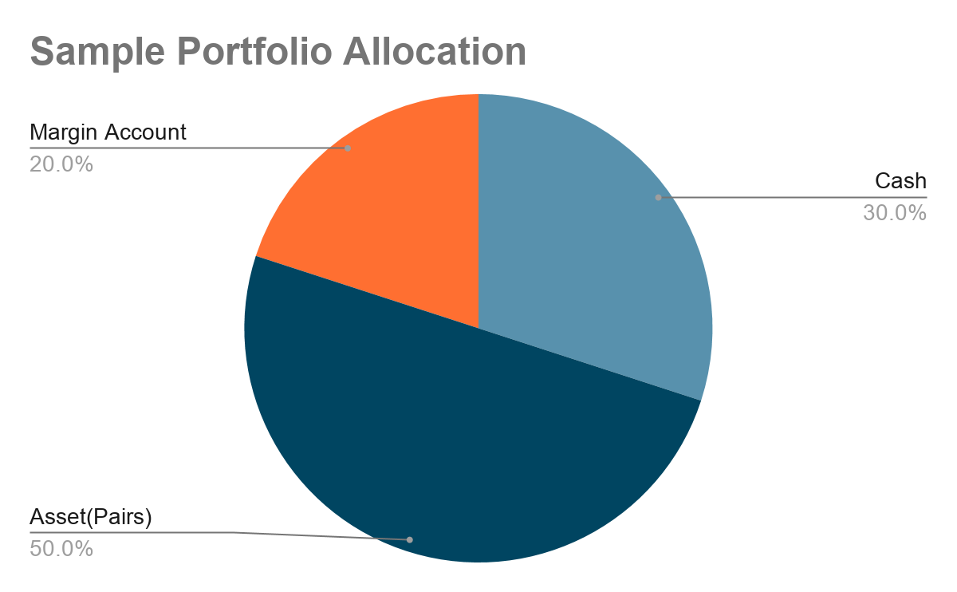
Methodology
Portfolio Construction
The portfolio consists of cash, assets, and a margin account
Pair weights (fixed): computed using inverse volatility
Market Neutral: Each pair can be treated as a beta-neutral long-short portfolio
Initial portfolio allocation: 20% margin account, 80% cash
Notes:
Cash- trading signal show up, enough cash to open position
Margin account-used when short selling assets
Fixed weights computed based on formation period data

Slide 11
Methodology
Backtesting Major Assumptions:
Formation period: 6 months
Trading period: 6 months
1
Commission Fees
Max($2.99, $0.01*# shares)
2
Slippage
N (0, 0.001)
3
Short-sell margin
100%
4
Fractional Shares
Cannot long/short a fraction of a share

Slide 12
Result
Sharpe Ratio:
The Sharpe ratio is a measure of risk-adjusted return. It describes how much excess return you receive for the extra volatility you endure for holding a riskier asset.
Usually, any Sharpe ratio greater than 1.0 is considered acceptable to good by investors.
A ratio higher than 2.0 is rated as very good.
A ratio of 3.0 or higher is considered excellent.
A ratio under 1.0 is considered sub-optimal.
Maximum Drawdown:
A maximum drawdown (MDD) is the maximum observed loss from a peak to a trough of a portfolio, before a new peak is attained. Maximum drawdown is an indicator of downside risk over a specified time period.
Optimally an account should experience drawdowns of 5-30% frequently. More than that is not necessary, less than 5% maximum will reduce capital gains unnecessarily.

Slide 13
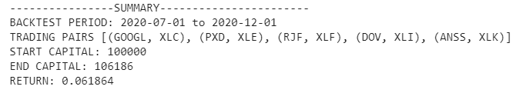
Result
Example 1:
Formation period：2020-01-01 - 2020-07-01
Sharpe ratio: 1.62
Maximum drawdown: 0.026

Slide 14
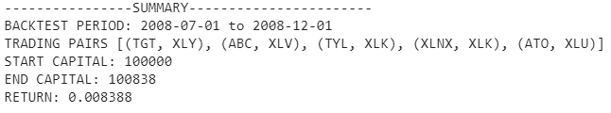
Result
Example 2:
Formation period：2008-01-01 - 2008-07-01
Sharpe ratio: 0.38
Maximum drawdown: 0.013

Slide 15
Limitations/Future work
Signal Construction
S-Score (2.0/-2.0) bar is very restrictive.
Making trading frequency very low.
Lower the S-Score bar could increase trades but might bring the return down.
Regression on multiple ETFs might make residuals more stationary

Slide 16
Limitations/Future work
Short Position (The issues with back testing a short stock strategy – Alvarez Quant Trading)
Even with highly liquid stocks, one may not be able to borrow shares (eg. 2008)
It costs something to borrow stocks but there is no consistency on borrow interest rate
Losses grow faster on short position compared to long position
Stock goes up 10% day-1, 10% day-2, short position lost 21%
Stock goes down 10% day-1, 10% day-2, long position lost 19%
Use combinations of options to replace short positions?

Slide 17

Limitations/Future work
Backtest/Strategy
Dynamically rebalance portfolio
Try different lengths of formation and trading periods
Runtime Efficiency (Regressions when calculate S-Scores make back-testing slow)
Backtest assumptions are limited
Assume simple transaction cost model: max($2.99, $0.01*shares)
Fixed slippage ~ normal(0, 0.001)
Traded on ‘Close’ price
Margin calls not considered (But 20% of capital reserved for margin call)
Unstable data provider/API can cause trouble

Slide 18

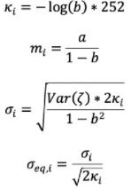

Conclusion
Workflow: Hyperparameters: for significance test, to enter trade
Pair Formation
Signal Construction (S-Score)
Portfolio Construction
Back-Testing
Cointegration Test
Long-short Beta Neutral in Pair
No Future Info Allowed
Stationary Test
Inverse Volatility among Pairs
Transaction Cost Included
Pair(Stock, ETF)
AR(1) approximate OU parameters
Dynamically Allocate order-size
Margin Reserved
S-Score:
Portfolio Records Every Transaction, Easy Analysis

Slide 19
Questions/Comments/Concerns
References
Marco Avellaneda and Jeong-Hyun Lee. Statistical Arbitrage in the US Equities Market. Quantitative Finance, 10(7):761–782, 2010. Retrieved from https://www.math.nyu.edu/faculty/avellane/AvellanedaLeeStatArb071108.pdf
George J Miao. High frequency and dynamic pairs trading based on statistical arbitrage using a two-stage correlation and cointegration approach. International Journal of Economics and Finance, 6(3):96, 2014. Retrieved from http://www.stagirit.org/sites/default/files/articles/a_0304_33007-117256-1-pb.pdf
Alexander Lipton and Marcos Lopez de Prado. A closed-form solution for optimal mean-reverting trading strategies. arXiv preprint arXiv:2003.10502, 2020. Retrieved from https://papers.ssrn.com/sol3/papers.cfm?abstract_id=3534445
Binh Do and Robert Faff . Does Simple Pairs Trading Still Work?, Financial Analysts Journal , July/August 2010, Vol. 66, No. 4 (July/August 2010), pp. 83-95. Retrieved from https://www-jstor-org.ezproxy.bu.edu/stable/25741293?seq=1#metadata_info_tab_contents
William N. Goetzmann. Pairs Trading: Performance of a Relative Value Arbitrage Rule. Review of Financial Studies (Feb 2006), DOI: 10.1093/rfs/hhj020. Retrieved from https://papers.ssrn.com/sol3/papers.cfm?abstract_id=141615

